Slide 3
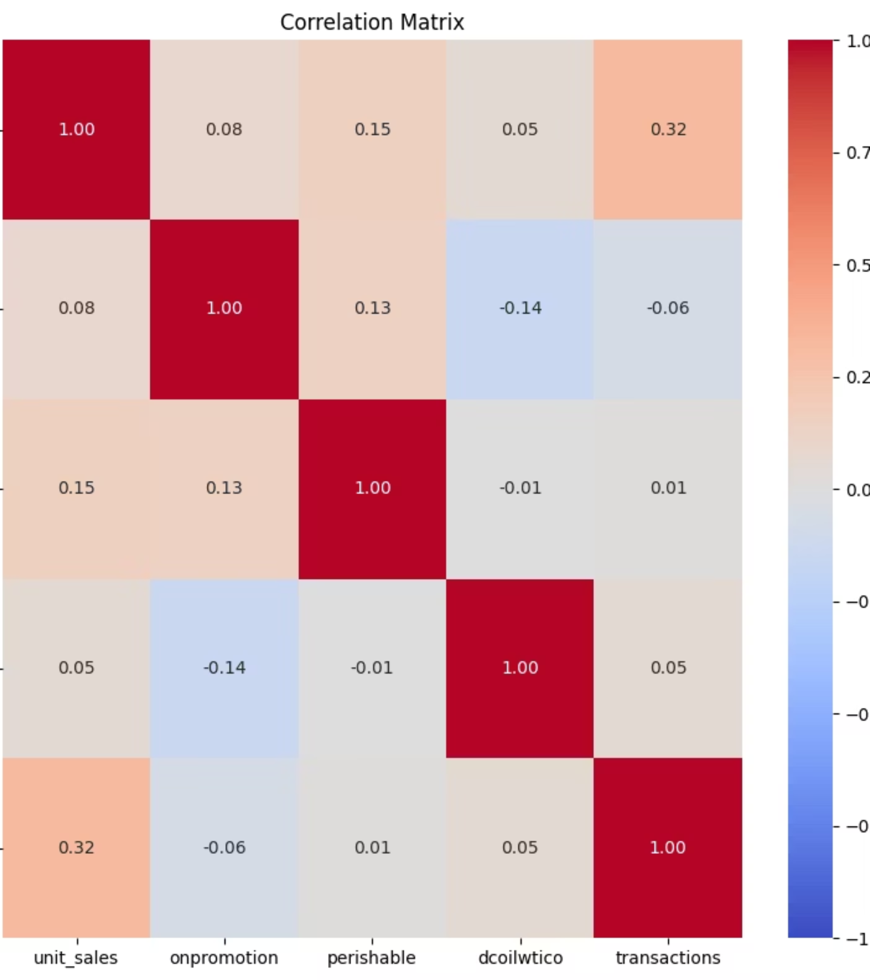
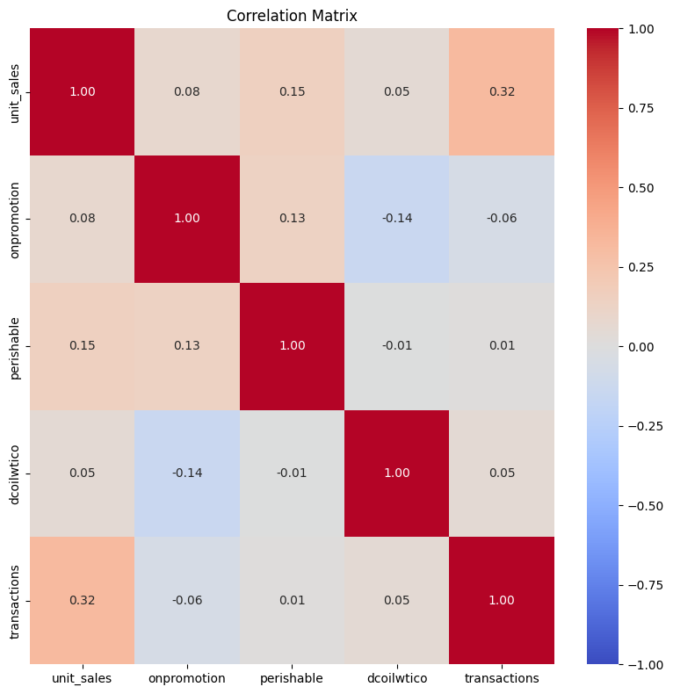
Understanding the Data
Correlation Analysis Reveals Key Drivers
Identifying relationships between variables helps us understand which factors most strongly influence unit sales patterns and seasonality in the data from
Favorita:
Equador – Guayas – Top 3 Item-Families

Slide 4
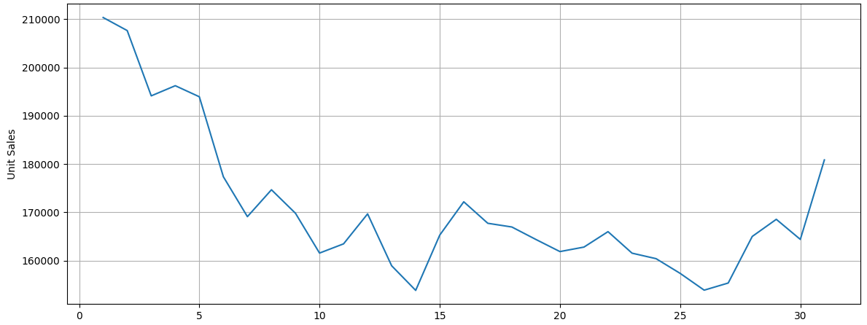
Monthly Sales Trend
Consistent Growth with Seasonal Patterns

Slide 5
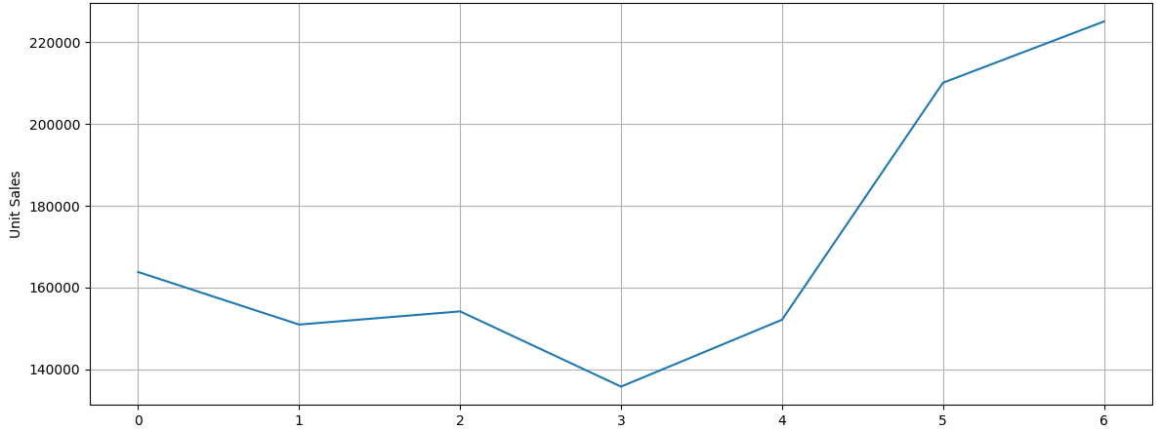
Weekly Sales Trend
Consistent Growth with Seasonal Patterns

Slide 6
Model Selection
Four Leading Forecasting Approaches Evaluated
ARIMA
SARIMAX
Autoregressive Integrated Moving Average
Seasonal ARIMA with Exogenous Variables
Classic time series model capturing linear trends and patterns
Extends ARIMA to handle seasonality and external factors
XGBoost
Prophet
Extreme Gradient Boosting
Facebook's Time Series Framework
Machine learning ensemble method for complex non-linear patterns
Robust to missing data and trend shifts, handles holidays automatically

Slide 7
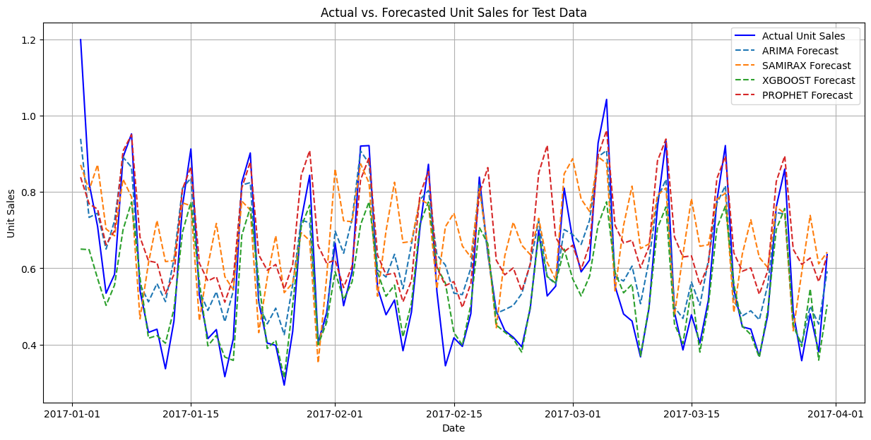
Forecast Comparison
Detecting Problems of Different Models

Slide 8

Model Performance Comparison
Error Metrics Across All Models
Mean Absolute Error (MAE)
XGBoost: 0.067 ✓
ARIMA: 0.080
Prophet: 0.122
SARIMAX: 0.152
Root Mean Squared Log Error (RMSLE)
XGBoost: 0.059 ✓
ARIMA: 0.062
Prophet: 0.092
SARIMAX: 0.115
Mean Squared Error (MSE)
ARIMA: 0.009 ✓
XGBoost: 0.011
Prophet: 0.021
SARIMAX: 0.033
XGBoost delivers superior accuracy across all key performance indicators, minimizing forecast error by 16% vs. ARIMA

Slide 9

Recommendation
Deploy XGBoost
Lowest Error Rates
Captures Complexity
Production Ready
MAE: 0.067 | RMSLE: 0.059
Handles non-linear relationships and interactions
Scalable architecture for real-time forecasting
Decent MSE: 0.011
Outperforms traditional statistical methods
Adapts to evolving demand patterns
Proven reliability across industries

Slide 10

Next Steps & Challenges
Enhanced Preprocessing
XGBoost Optimization
Feature engineering and data quality improvements to boost accuracy
Enhance Hyperparameter tuning and cross-validation to maximize model performance
Path Forward
Conduct systematic hyperparameter grid search
Implement feature selection and dimensionality reduction
Deploy automated retraining pipeline for ongoing accuracy

